Slide 1


Dawood University of Engineering and Technology
Instructor
Faisal
Department
CyberSecurity – A2
Presented by:
Mubeen Ul Haq : 25F-CY-075
Arshad Ali : 25F-CY-071
AjeebUllah : 25F-CY-092

Slide 2

Introduction
The All India Muslim League was an important political organization formed to protect the political, social, and economic rights of Muslims in British India. It was established at a time when Muslims felt that their interests were not properly represented in the political system. Over time, the Muslim League became the leading political voice of Muslims and played a decisive role in the struggle that eventually led to the creation of Pakistan in 1947.

Slide 3
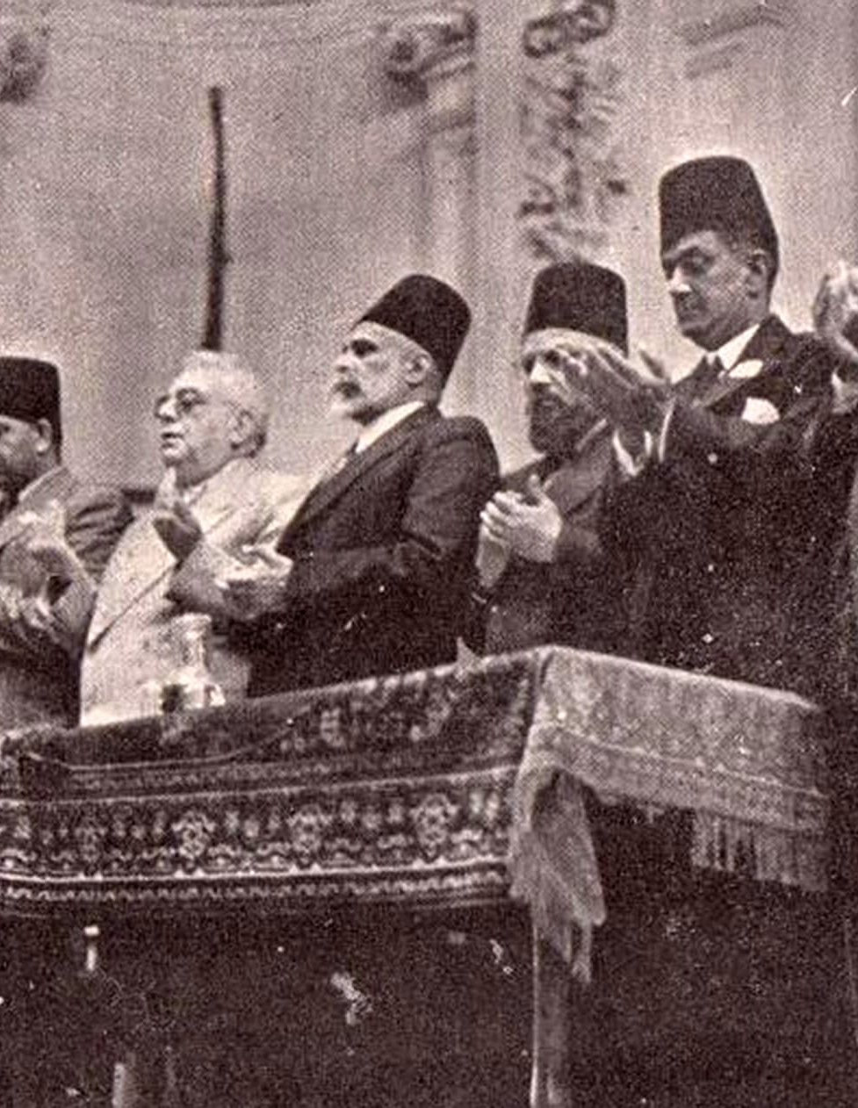
Formation of All India Muslim League
The All India Muslim League was founded on 30 December 1906 in Dhaka. It was created by Muslim leaders who wanted a separate political platform to represent Muslim interests. The main aim was to safeguard the political rights of Muslims and ensure that Muslims had proper representation in government and political institutions.

Slide 4
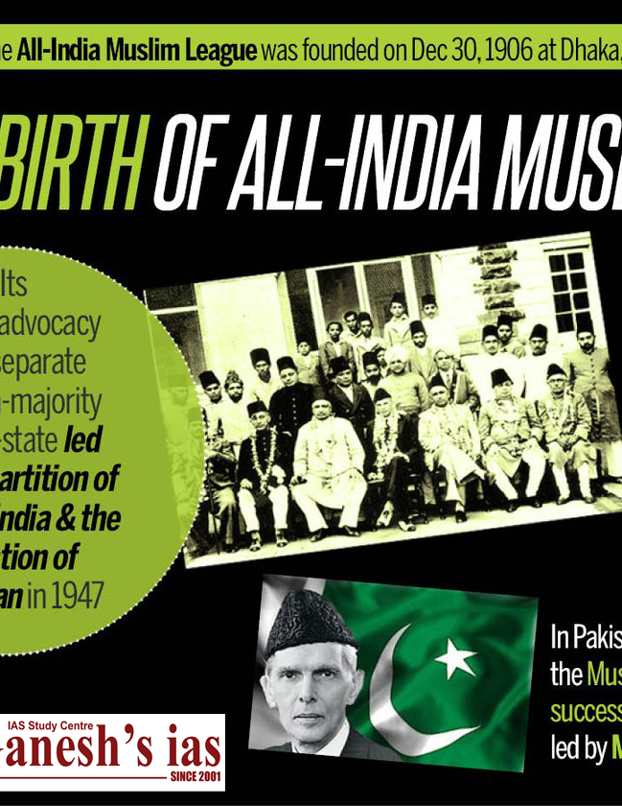
Objectives of Muslim League
The Muslim League had several important objectives at the time of its creation: Protect the political rights and interests of Muslims in British India. Promote loyalty to the British government in the early years in order to gain political support. Develop a sense of unity, cooperation, and political awareness among Muslims of the subcontinent. Encourage Muslims to participate actively in politics.

Slide 5
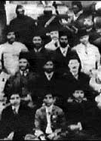
Early Struggles
During the early years, Muslims in the subcontinent felt politically, socially, and economically weaker compared to other communities. They feared that in a democratic system dominated by the Hindu majority, Muslim rights might be ignored. The Muslim League therefore worked to ensure fair representation for Muslims in government jobs, educational institutions, and legislative councils.

Slide 6
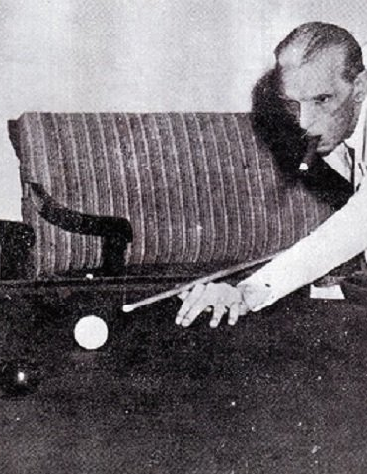
Leadership of Muhammad Ali Jinnah
Muhammad Ali Jinnah later emerged as the most important leader of the Muslim League. Due to his strong leadership, political vision, and determination, he united Muslims under a single political platform. He argued that Muslims were a separate nation with their own culture, religion, and traditions, and therefore needed a separate homeland where they could live freely according to their beliefs.

Slide 7

Allama Iqbal's Vision for Muslims
Before the demand for Pakistan became a mass political movement, the idea of a separate Muslim homeland was strongly supported by the philosopher and poet Allama Muhammad Iqbal. He believed that Muslims of the subcontinent had a unique culture, religion, and civilization that needed protection and development. Iqbal emphasized the importance of Muslim unity, self‑respect, and political independence. His ideas inspired many Muslim leaders and played an important intellectual role in shaping the future demand for Pakistan.

Slide 8
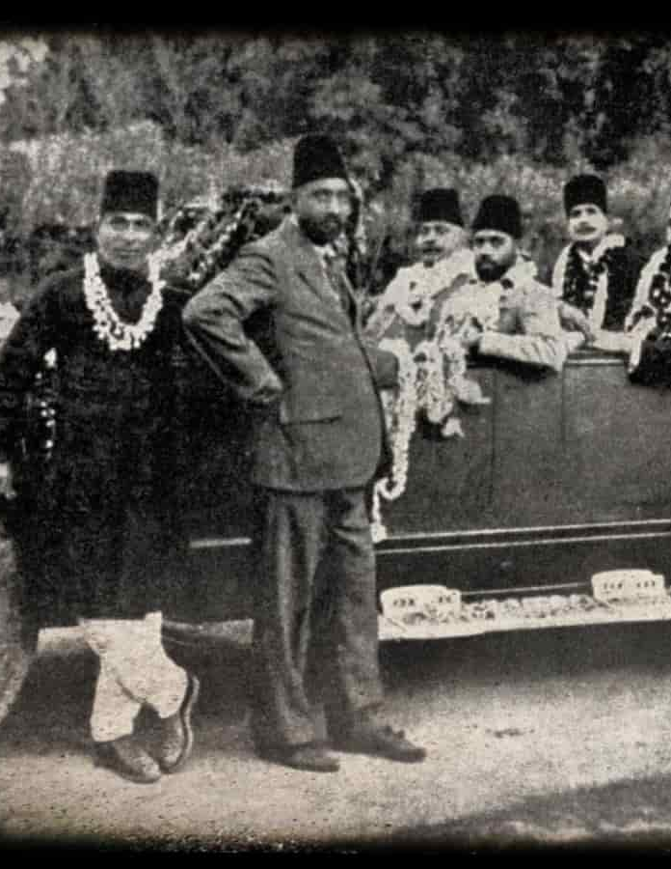
Allahabad Address (1930)
In 1930, Allama Iqbal delivered his famous presidential address at the annual session of the All‑India Muslim League in Allahabad. In this speech, he proposed the idea of a separate state for Muslims in the north‑western regions of India, including Punjab, Sindh, Balochistan, and the North‑West Frontier Province. This address is considered one of the earliest clear visions of what later became Pakistan and it greatly influenced Muslim political thinking.

Slide 9
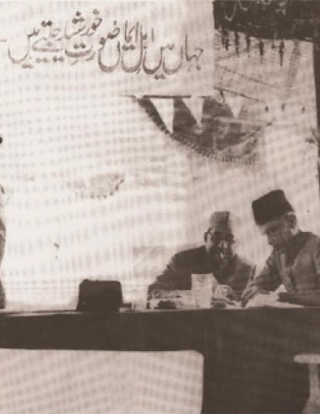
Lahore Resolution (1940)
In March 1940, the Muslim League held an important meeting in Lahore where the historic Lahore Resolution was passed. This resolution demanded that independent states should be established in the Muslim-majority regions of the subcontinent. The Lahore Resolution later became the foundation of the demand for Pakistan and gave a clear direction to the Pakistan Movement.

Slide 10
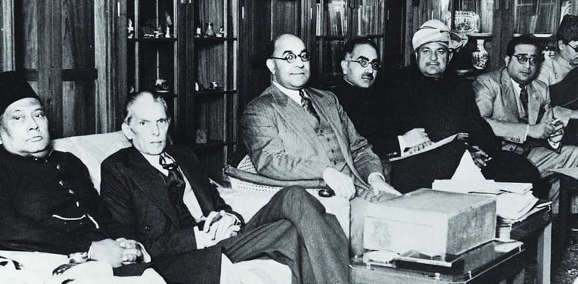
Role in Pakistan Movement
The Muslim League played a central role in organizing and leading the Pakistan Movement. It mobilized Muslims across the subcontinent and created political awareness about the need for a separate homeland. Through meetings, speeches, political campaigns, and negotiations with the British government, the Muslim League strengthened the demand for Pakistan.

Slide 11
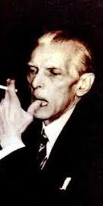
Creation of Pakistan
After many years of political struggle, negotiations, and sacrifices, the dream of a separate Muslim state finally became a reality. On 14 August 1947, Pakistan was created as an independent country for Muslims of the subcontinent. The Muslim League successfully achieved its goal and became the driving force behind the establishment of Pakistan.

Slide 12
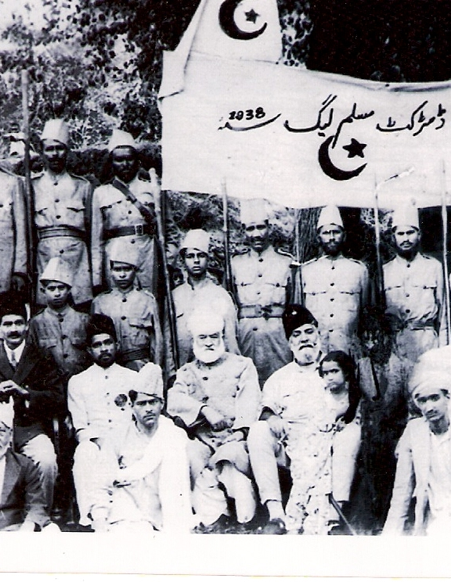
Historical Significance
The efforts of the Muslim League changed the political history of South Asia. It provided Muslims with a strong political identity and united them under one leadership. The party's role in shaping the Pakistan Movement is considered one of the most significant political achievements in the history of the region.

Slide 13
Conclusion
In conclusion, the All India Muslim League played a vital and historic role in the creation of Pakistan. Through political leadership, unity among Muslims, and continuous struggle, the Muslim League succeeded in achieving a separate homeland for Muslims. Its contributions remain an important part of Pakistan's national history.

Slide 14
Thank You!

